Slide 1
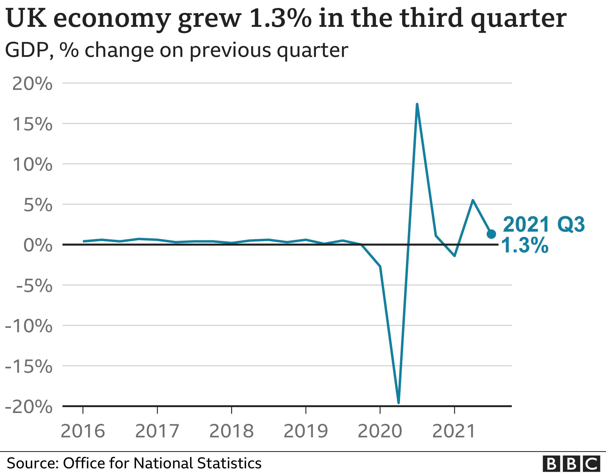
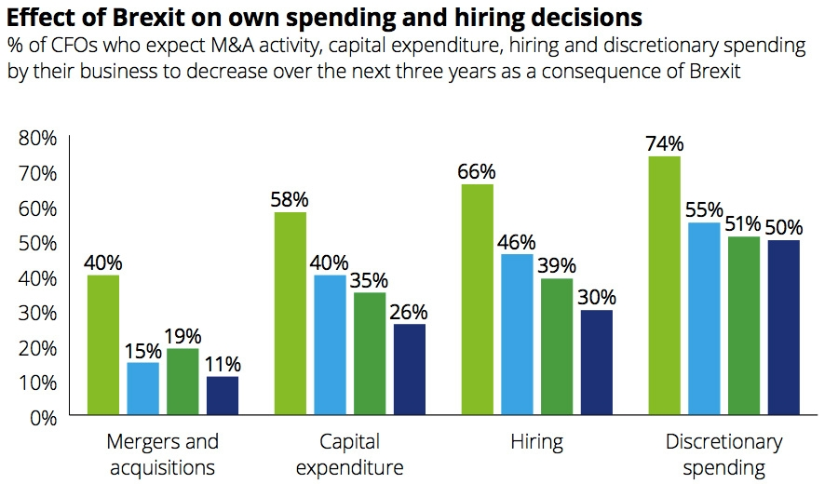
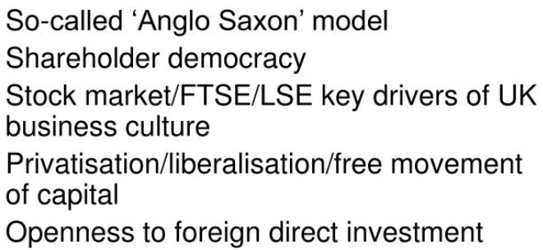
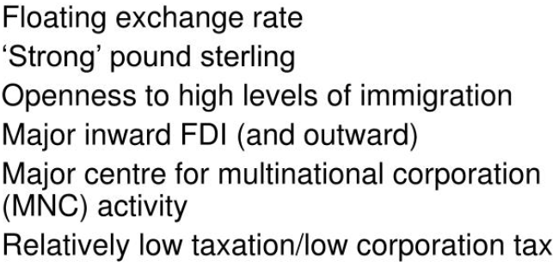
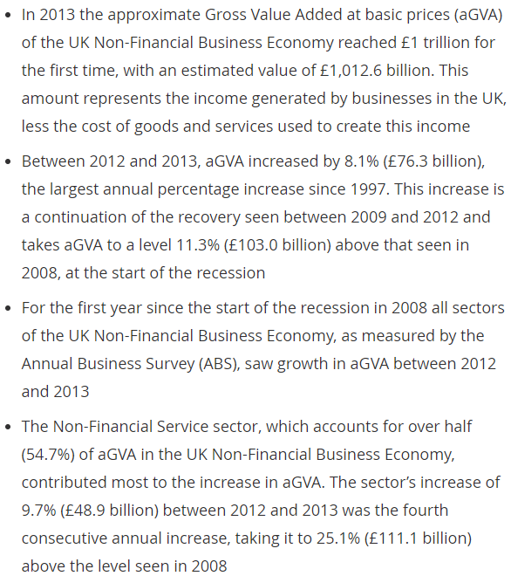
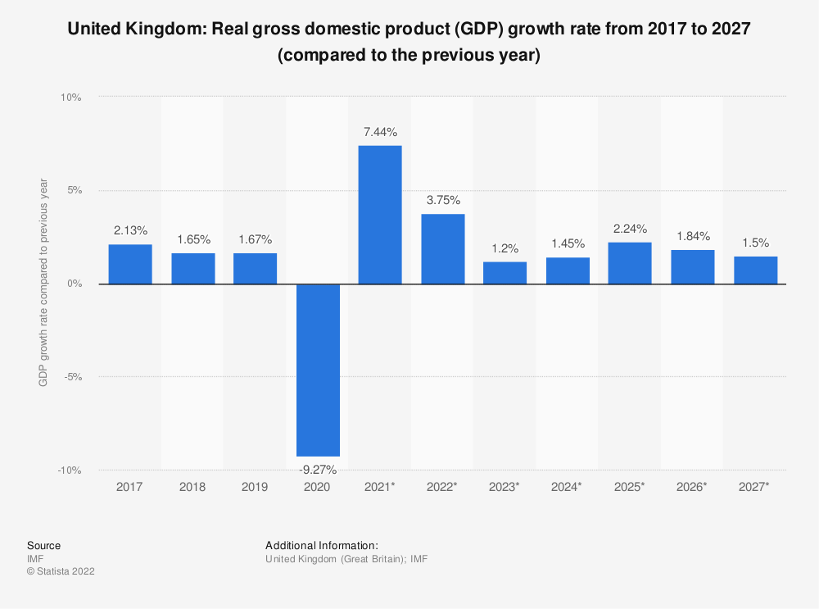
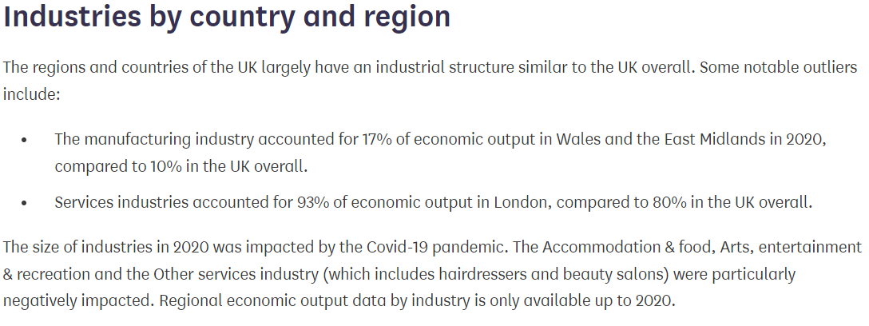
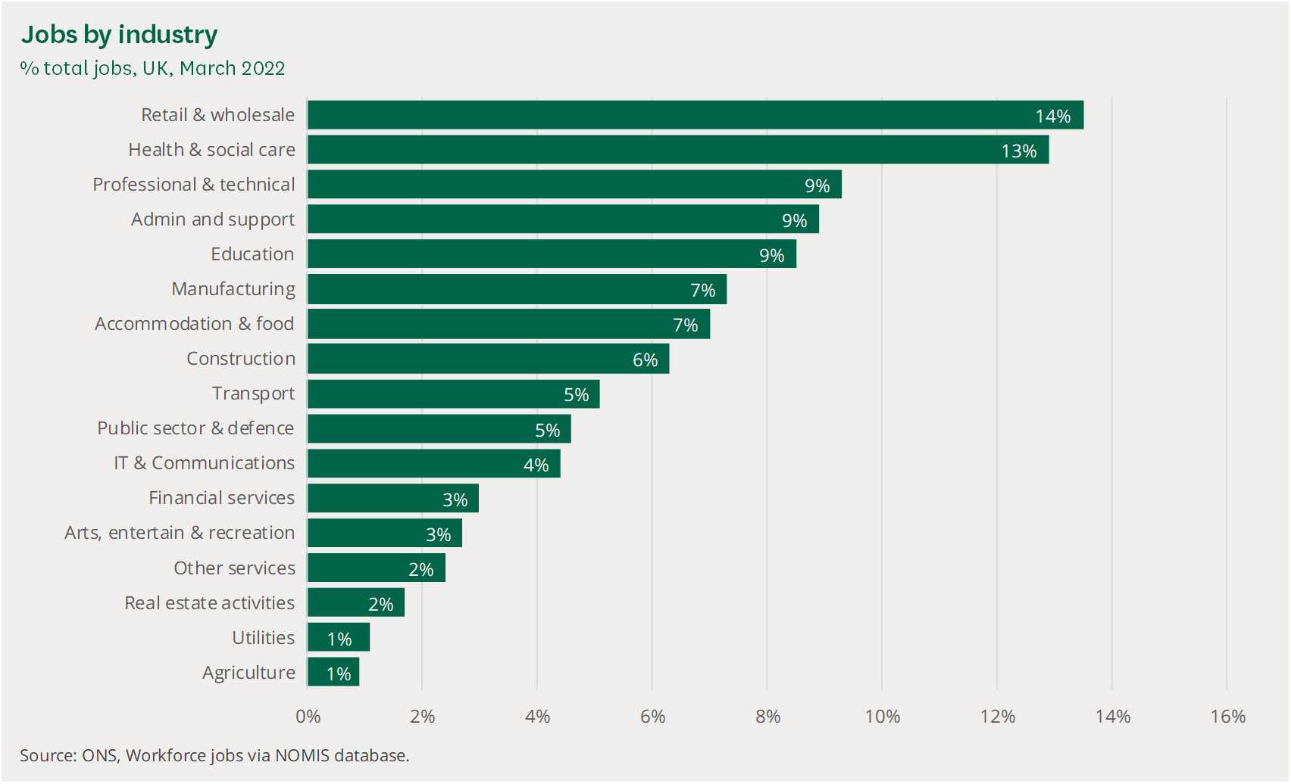
Business Environment of UK
Business Culture of UK
Free Market Economy
It denotes a return from last month, when it was said Gross domestic product went somewhere near 0.3% - in spite of the fact that it overhauled this figure toward the beginning of today to 0.2%.
Gross domestic product is utilized to gauge the presentation of a nation's economy. At the point when Gross domestic product goes up, the economy is for the most part remembered to do effectively.
However, when it goes down, it carries with it falling wages, work cuts and lower utilization. Market analysts anticipated the economy would show no development between April to May.
That is on the grounds that the Bank of Britain assessed Gross domestic product would contract between the long periods of April to June. In any case, most recent figures show that each of the three principal areas of the economy - administrations, assembling and development - performed surprisingly good.
Wellbeing administrations likewise assisted with supporting development, chiefly determined by an enormous ascent in GP arrangements.
Non-Financial Economy of UK
GDP Projections for UK

Slide 2
References
Beaver, G. and Prince, C., 2004. Management, strategy and policy in the UK small business sector: a critical review. Journal of small business and enterprise development. https://www.emerald.com/insight/content/doi/10.1108/14626000410519083/full/html
Crick, D., Chaudhry, S. and Crick, J.M., 2018. Risks/rewards and an evolving business model: A case study of a small lifestyle business in the UK tourism sector. Qualitative Market Research: An International Journal, 21(2), pp.143-165. https://www.emerald.com/insight/content/doi/10.1108/QMR-01-2017-0001/full/html
Tijssen, R., van de Klippe, W. and Yegros, A., 2019. Globalisation, localisation and glocalisation of university-business research cooperation: General patterns and trends in the UK university system. https://apo.org.au/node/234406
Oderanti, F.O. and Li, F., 2018. Commercialization of eHealth innovations in the market of the UK healthcare sector: A framework for a sustainable business model. Psychology & Marketing, 35(2), pp.120-137. https://onlinelibrary.wiley.com/doi/abs/10.1002/mar.21074
Duvier, C., Neagu, D., Oltean-Dumbrava, C. and Dickens, D., 2018. Data quality challenges in the UK social housing sector. International Journal of information management, 38(1), pp.196-200. https://www.sciencedirect.com/science/article/pii/S0268401216308222
Lee, D., 2018. Independent television production in the UK: From cottage industry to big business. Springer. https://link.springer.com/content/pdf/10.1007/978-3-319-71670-1.pdf
Stewart, E. and Connolly, C., 2022, October. UK public sector fiscal reporting: clear and contradictory. In Accounting Forum. Elsevier BV. https://pure.qub.ac.uk/en/publications/uk-public-sector-fiscal-reporting-clear-and-contradictory
Shome, T., 2018. A Comparative Study of the Impact of Motivational Theories on the Employees of IT and Financial Sector in a UK based Business Organisation (Doctoral dissertation, Dublin, National College of Ireland). http://norma.ncirl.ie/id/eprint/3312
Liu, J., 2018. Policy Briefing-Management Capability, Business Support and the-Performance of Micro-businesses in the UK. https://policycommons.net/artifacts/2476798/policy-briefing/3498855/
Stewart, E. and Connolly, C., 2022, October. UK public sector fiscal reporting: clear and contradictory. In Accounting Forum. Elsevier BV. https://pure.qub.ac.uk/en/publications/uk-public-sector-fiscal-reporting-clear-and-contradictory

