Slide 1
International Business Environment CW2 Assignment Briefing

Slide 2
Vision & Mission HC
Organisational Structure HC
SWOT HC
What are the main SWOT differences between the host and target country?
PESTEL HC
Differences?
PESTEL TC
Yip’s Int. Drivers
External factors & current company actions
External factors & identification of potential company actions
Which is the predominant driver that forces the company to internationalise?
Market?
Cost?
Competitive?
Global?
Key int. drivers?
Identify key drivers
What are the key drivers that contribute to the success of the company?
(Yip’s drivers can also be used to create scenarios)
Key PESTEL drivers?
Create scenarios from PESTEL and/or YIP int. drivers. Which is the best one?
Create Scenarios
Culture analysis
Correlate External Factors
What are the cultural differences between HC and TC? (use CAGE & Hofstede)
Cultural differences?
To what extent can products be standardised across national boundaries or need to be adapted to meet local requirements?
Match external factor differences? (O&T)
Preferred scenario
Identification TC attractiveness:
Threat of entry
Threat of substitutes
Bargaining power of buyers (customers)
Bargaining power of suppliers
Rivalry between competitors
Porter’s 5-Forces TC
Global-local standardisation analysis
SWOT TC
Internal strengths & weaknesses
Global / local driver?
TC attractiveness
Mode of Market Entry
4 gen. int. strategies
Identify the best market entry mode for your TC? (Which is the best market entry mode? Is it:
Export?
License or franchise?
Joint venture?
Wholly owned subsidiary (FDI)?
Define the internationalisation strategy (Export, Global, Transnational, Multi-domestic) according to
Global / local drivers
Internal Strengths and weaknesses
TC attractiveness
Culture
Scenarios
HC Home Country
TC Target Country

Slide 3
The Executive Summary
Definition:
An executive summary, or management summary, is a short document or section of a document, produced for business purposes, that summarises a longer report or proposal or a group of related reports in such a way that readers can rapidly become acquainted with a large body of material without having to read it all.
This is the last section you write.
Take 1-2 key issues from each section and summarise them in maximum 1-2 paragraphs.

Slide 4
TOC: Table of Contents
Don’t forget!
Generate using Word functionality.
https://support.microsoft.com/en-us/help/285059/how-to-create-a-table-of-contents-by-marking-text-in-word

Slide 5
1.1 Background to the Study
Provide some background to the study.
Why are YOU doing this study?
… part of the International Business course to obtain the degree of BA, etc.

Slide 6
1.2 Aims and Objectives
What are the aims and objectives of this study?
i.e.
To analyse xyz’s current position and internationalisation strategy for a potential expansion to (host country) and based on this analysis, suggest a strategic option.

Slide 7
2.0 Company Overview
Provide some information about the company.
This section contains information about:.
The company’s background
Do they have internationalisation experience? If so was it successful or a failure? Why?
The company’s vision and mission
The company organisation
The company’s firm and country specific advantages

Slide 8
2.1 Company Vision and Mission
What is the company’s vision?
What is the company’s mission statement?
If you can’t find them, write about what you could find.
If you can’t find them, suggest them in the recommendation section at the end of the report.

Slide 9
2.2 Company Organisation
How is the company organised?
What kind of structure does it have?
Do they already have subsidiaries abroad?
Provide an organisation chart.

Slide 10
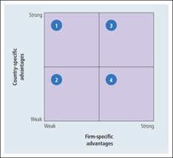
2.3 Firm and Country Specific Advantages
Create and place an FSA/CSA matrix in the paper and show in which quadrant you would position it.
Write a short paragraph explaining why you think the company is in the quadrant you selected.

Slide 11
3. Company’s Home Country Analysis
In this section you write about the company in the home country.
Home Country SWOT analysis
Home Country External Environment Analysis.

Slide 12
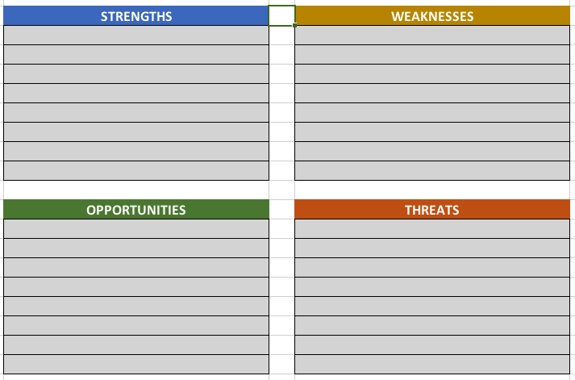
3.1 Home Country SWOT Analysis
Use the SWOT_Template.xls and write a short summary about the most relevant SWOT factors.

Slide 13
3.2 Home Country External Environment Analysis
Create a PESTEL analysis of the home country.
Use the PESTEL_Template.xls
Identify 2-4 major factors that are key factors contributing to the success of the company and use them in the Hypothetical Scenarios chapter

Slide 14
3.2 Home Country External Environment Analysis
Create a PESTEL analysis of the target country. Identify two (or 4) major factors that contribute to the success of the company? Use them to create hypothetical scenarios.
Compare the PESTEL home country with the PESTEL target country. Are there important and major differences that could influence the success of the company’s internationalisation? If so, keep these in mind and write about them in the conclusion.

Slide 15
3.2 Home Country External Environment Analysis
Use PESTEL_Template.xlsx
Cut and paste the first 3 columns into your document

Slide 16
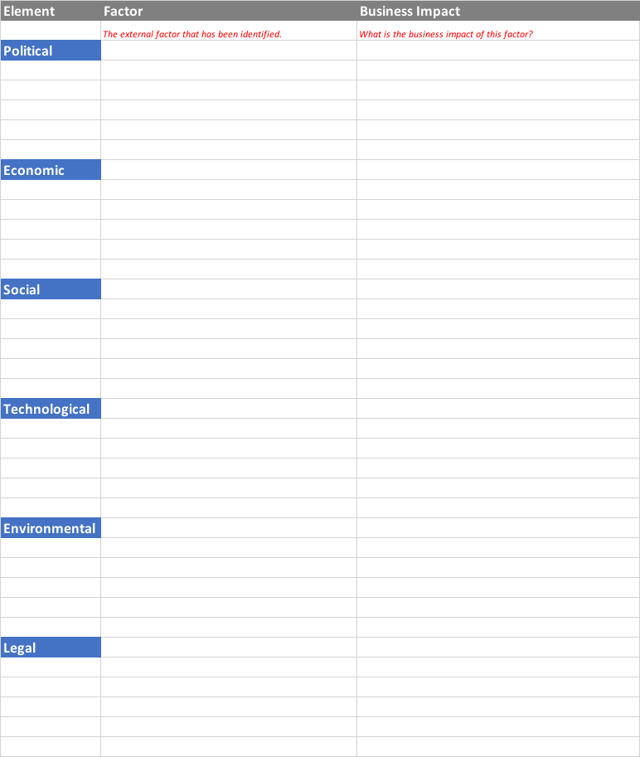
3.2 Home Country External Environment Analysis

Slide 17
4.0 Target Country Analysis
In this chapter you write about your selected target country.
It includes:
Home Country SWOT analysis
Home Country External Environment Analysis

Slide 18
4.1 Target Country SWOT Analysis
Similar to the Home Country SWOT analysis you create a SWOT for the target country.
Use the SWOT_Template.xls
What are the most relevant factors and which are the main ones that differ from the home country SWOT analysis?

Slide 19
4.1 Target Country SWOT Analysis

Slide 20
4.2 Target Country External Environment Analysis
Create a PESTEL analysis of the target country. Identify two (or 4) major factors that contribute to the success of the company? Use them to create hypothetical scenarios.
Compare the PESTEL home country with the PESTEL target country. Are there important and major differences that could influence the success of the company’s internationalisation? If so, keep these in mind and write about them in the conclusion.
Use the PESTEL_Template.xls (cut and paste into your document)

Slide 21
4.2 Target Country External Environment Analysis

Slide 22
5.0 Company Key Drivers and Hypothetical Scenarios
In this chapter you identify the company’s key drivers and create scenarios. The scenario axes can come from one or more of these drivers
Internationalisation Drivers
Company Key Drivers
Hypothetical Drivers

Slide 23
5.1 Internationalisation Drivers
Use the Internationalisation_Drivers_Template xls to analyse and explain why the company should internationalise.

Slide 24
5.1 Internationalisation Drivers

Slide 25
5.1 Internationalisation Drivers
Enter the degree of internationalization driver

Slide 26
What is the main internationalization driver?
Summarise the main driver with one or two sentences.

Slide 27
Internationalisation Driver
Paste the graph into your document.

Slide 28
5.2 Company Key Drivers
Look at your PESTEL and Yip’s internationalization drivers and identify the 2 main factors
Create 2 axis
Identify the 4 different scenarios

Slide 29
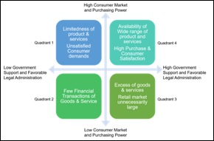
5.3 Hypothetical Scenarios

Slide 30
6. Target Country Attractiveness
In this section you identify how attractive is for the company to expand to.
It includes:
Porter’s 5 Forces analysis
Use Porters5ForcesCalc.xls

Slide 31
Porters5ForcesCalc.xls template
Enter the threat level

Slide 32
Porters5ForcesCalc.xls template
How attractive is the internationalisation level

Slide 33
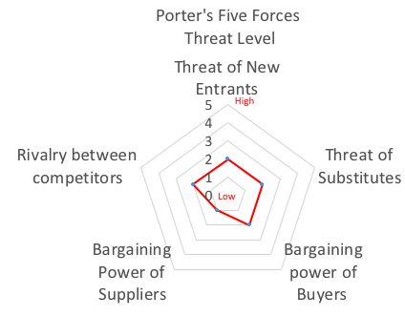
Porters5ForcesCalc.xls template
Paste the graph into the document and summarise.

Slide 34
7. Culture Issues
Use Hofestede and CAGE to analyse the culture differences between the home and target country.
https://www.hofstede-insights.com

Slide 35
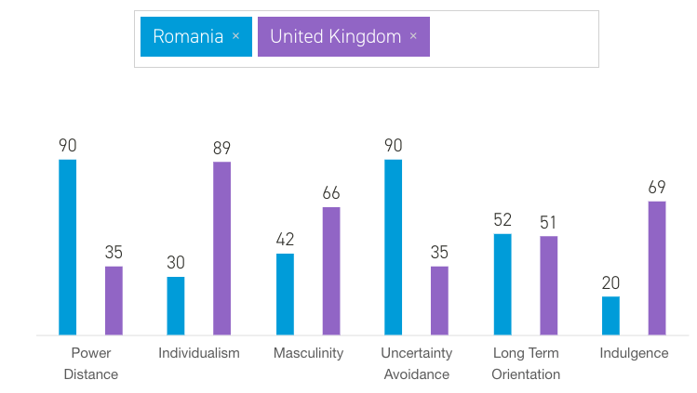
Hofstede analysis
Use https://www.hofstede-insights.com and/or CAGE
Cut and paste figure into your document:

Slide 36
7.2 Global-Local Standardisation Analysis
Do the products, packaging, etc. need to be modified because of the culture and standards in the target county?

Slide 37
8. Internationalisation Evaluation
In this section you analyse what kind of market entry mode and which is the best generic strategy for the company in expanding their operations to the host country.

Slide 38
8.1 Mode of Market Entry
This is where you describe your suggested market entry mode. It is either, Export, Licence or Franchise, Joint venture, or Wholly owned subsidiary (or FDI). Describe why the one you have chosen is the best one.

Slide 39
8.1 International Strategy
By looking at your previous analysis and findings, identify points that support your suggestion for an international strategy. Describe your reasons. (Export, Global, Transnational, or Multi-domestic).

Slide 40
9. Conclusion and Recommendations
This section provides the reader, based on your analysis, with your conclusions and recommendations and how successful you evaluate the company’s international expansion strategy into the host country

Slide 41
Bibliography
Important: 10 – 20 academic citations.
Tip: Use Google Scholar to find references
Use APA / Harvard standard
Generate using Word functionality
https://support.office.com/en-us/article/create-a-bibliography-citations-and-references-17686589-4824-4940-9c69-342c289fa2a5

Slide 42
12. Appendices
You may use this to place graphs, figures, and additional information. You refer to them in your text i.e. “See appendix xx”.

