Slide 1
Company: Enter Company name here Campaign: Enter Campaign name here Product or Service: Enter Product or Service name here
1
CAMPAIGN PROPOSAL
Marketing Director: Enter Student Name here
Chief Marketing Officer: Enter Professor Name here
Submitted on: Enter Date here

Slide 2
2
Product / Service and Features
PRODUCT / SERVICE DESCRIPTION
Instructions: Include a description of your product or service. What is its core function or purpose? Write a full paragraph.
Replace this box with Logo or Photo representing your Product or Service.
Enter Description:
KEY FEATURES & BENEFITS
Instructions: Name and describe at least three key features of your product or service.
Feature Name | Description of Benefit
“Click to Order” capability | Allows end-user to submit order updates in real time reducing shipping delays and mistakes by 15%

Slide 3
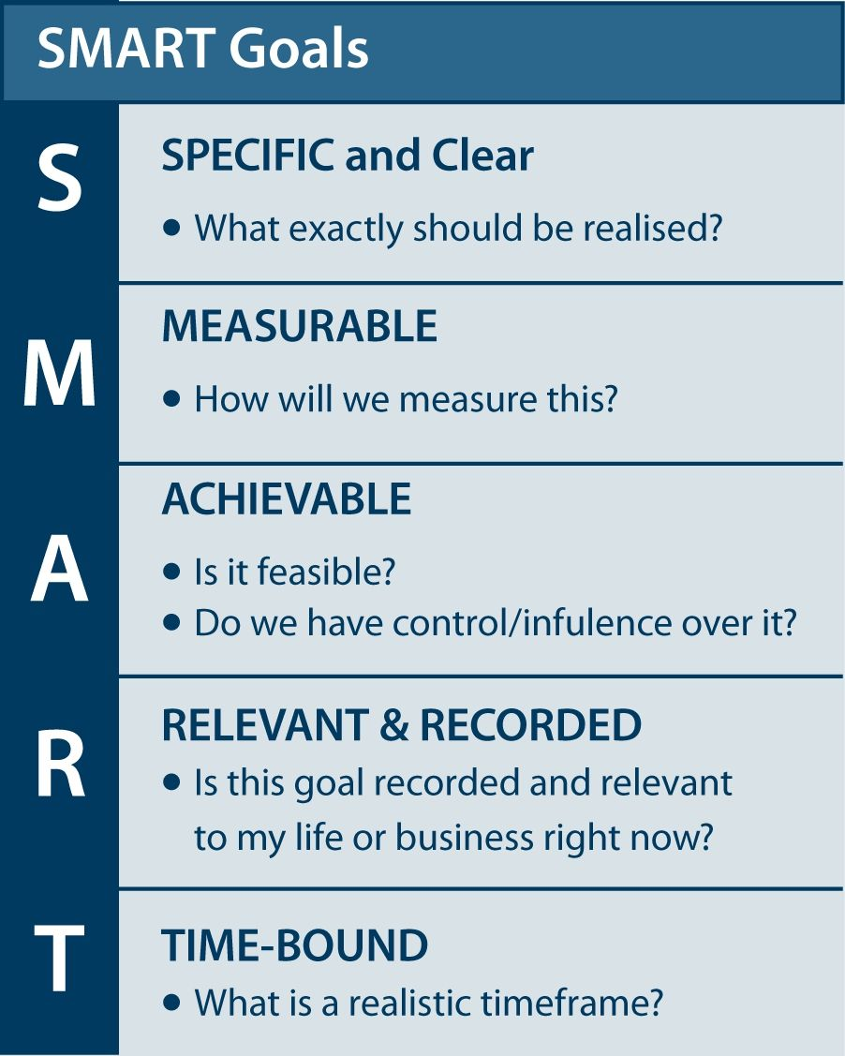
3
SAMPLE GOALS
Build brand awareness
Increase in number of items sold
Growth in market share
Capture a new target market
Increase overall company revenues
Increase donations to organization
Add new accounts or relationships
Improve ROI on advertising expenditure
Enhance the company’s image
SAMPLE SMART DESCRIPTIONS
Goal: Build brand awareness
Description: Ensure 80% of target segments become aware of the offering within 6 months of launch.
Goal: Growth in market share
Description: Capture at least 3% of the product’s category share from competitors within Year One.
Goal: Add new accounts or relationships
Description: Increase requests for quotes (in value terms) by 10% in Year One and by 25% in Year Two.
Marketing Goals
CAMPAIGN MARKETING GOALS AND DESCRIPTIONS
Instructions: Provide three to five marketing goals for the campaign. Use the five SMART elements to create a detailed description of each goal.
Marketing Goal | SMART Description (Specific, measurable, achievable, relevant, time-bound)
Marketing Goal 1
Marketing Goal 2
Marketing Goal 3
Marketing Goal 4
Marketing Goal 5

Slide 4
4
Target Audience and Competition
TARGET AUDIENCE DESCRIPTION
What are the key characteristics of your target audience?
Response:
DIFFERENTIATION of your BRAND
How will you differentiate your brand from the competition?
Response:
COMPETITIVE CAMPAIGN ANALYSIS
Instructions: Search the Web for the campaigns of two competitors with a similar product or service. Using all the rows in the table below, summarize how your campaign compares to the campaigns of these two competitors.
COMPARISON | COMPANY & PRODUCT/SERVICE | COMPETITOR 1 | COMPETITOR 2
NAME of COMPANY and NAME OF PRODUCT/SERVICE: | Response: | Response: | Response:
KEY FEATURES and BENEFITS: What are the top features of the product, from the customer perspective? | Response: | Response: | Response:
TARGET AUDIENCE: Describe the best target audience for this product. | Response: | Response: | Response:
PRICE: What is your best estimate of the cost to be charged for the product or service? | Response: | Response: | Response:

Slide 5
5
Customer Needs and Wants
CUSTOMER NEED
What customer “need” does the product or service address? What value does it deliver to the customer? Why would a customer buy it?
Response: Begin your paragraph with, “Customers need…”
CUSTOMER WANTS
What customer “wants” does the product or service fulfill? How does it reinforce the customer’s self-image? How does it connect the customer with others?
Response: Begin your paragraph with, “Customers want…”

Slide 6
6
Customer Values and Beliefs
CUSTOMER VALUES AND BELIEFS
What are the core values and beliefs of your target audience?
Response: Begin your paragraph with, “Customers value and believe…”
BRAND CONNECTION TO VALUES AND BELIEFS
How will this campaign connect your brand to those customer values and beliefs?
Response: Begin your paragraph with, “Our brand connection to customer needs and values is…”

Slide 7
7
Marketing Messages and Story
MESSAGES
What are the key features you need to highlight in your marketing messages for this campaign?
Response:
MARKETING STORY
What is the “story” you will use to appeal to customers in this campaign?
Response:
WORDS AND IMAGES
What words and images will you use to “frame” your marketing story in this campaign?
Response:

Slide 8
8
Social Media Strategy
TOP THREE ADVERTISING CHANNELS, DEMOGRAPHICS and USE of SOCIAL MEDIA
Where will you advertise to reach your target audience for this campaign?
Social Media Channel | Universe Size* | Ideal Demographic(s) | Cons of Channel
* Universe size pertains to the number of users from your specific target audience that use the platform. See the Tutorial for more information and research recommendations.
ENGAGEMENT
How will you use social media to engage your audience for this campaign?
Response:
EXPAND MESSAGE
How will you use social media to spread your marketing message widely in this campaign?
Response:

Slide 9
9
Marketing Metrics and Budget Allocation
HOW WILL YOU ALLOCATE YOUR BUDGET FOR THIS CAMPAIGN?
Over 50% of the Budget must be for Digital Marketing Channels versus Traditional. You must have a minimum of 4 Marketing Categories.
SAMPLE CHART: Replace the contents of the chart below with your own budget items.
Marketing Category | Budget | % | Type | Why This Category? | Metric Calculation | Frequency of Data Collection | Why These Metrics?
Facebook | $300,000 | 30% | Digital | With target age of 50….. | What Metric(s) can you calculate with this data? | Weekly | Because our goal is more repeat users …
Twitter | $100,000 | 10% | Digital | Twitter and Facebook….. | What Metric(s) can you calculate with this data? | Daily | More endorsements will lead to …
LinkedIn | $250,000 | 25% | Digital | Because the buyers … | What Metric(s) can you calculate with this data? | Monthly | To build a community on this site, we must measure …
Radio | $100,000 | 10% | Traditional | We will focus our radio efforts …. | What Metric(s) can you calculate with this data? | Bi-Monthly | By knowing which radio programs our buyers prefer, we can …
Outdoor Billboards | $150,000 | 15% | Traditional | For billboards….. | What Metric(s) can you calculate with this data? | Quarterly | To determine the best locations for our ads …
TOTAL | $1,000,000 | 100%
For Metrics, consider these questions: How will you measure your campaign’s performance? What are the key data items you need? How frequently will you collect these data items? What metrics will you calculate, based on the campaign data? Why are these metrics useful?

Slide 10
10
Conclusion
BENEFITS OF THE PROPOSED CAMPAIGN
Describe the short term and long term benefits of a successful campaign
Enter description:
REASONS TO ENDORSE THE PROPOSAL
Specify the reasons why the executive team should endorse your proposal
Specify reasons:
THANK YOU!
Thank your audience and invite questions
Conclude your presentation:

Slide 11
References
Your References list should reflect 7 weeks of learning and content, including textbook readings, articles, lectures, and external content you found in your research.
You should conduct research so that you will be knowledgeable on your target market, segmentation and other critical factors in developing a sound campaign plan.
Include a numbered list of the sources used in your presentation (the numbers indicate the order in which you used them). A well-researched assignment has at least as many sources as pages or slides. Use the number one (1) for the first source used in the paper, the number two (2) for the second source, and so on. Use the same number for a source if you use it multiple times in your presentation.
References must be included here for any content you obtained from market data or third-party sources.
You may add an extra References slide if needed.
Note that your References slides do not count towards the total of 15 slides.

