Slide 1
Bachelor of Business Studies (BBS)
Topic 8 Performance Management

Slide 2
Purpose of the Session
To review the objectives and elements of a performance management process
To examine the measurement of performance through the appraisal process

Slide 3
Reading
Core textbook – Chapter 8
See supplementary reading list in the study guide

Slide 4
PROBLEMS WITH TRADITIONAL PM PRACTICES
Ratings and reviews: use, abuse and misuse
Pros: a central element of HR practices; the only logical means to appraise, develop, and effectively use the knowledge and abilities of employees
Cons: ‘nourishes short-term performance, annihilates long-term planning, builds fear, demolishes team-work, nourishes rivalry and politics’; results in employee burnout; lack of effective feedback; negative feedback produces recipient defensiveness and distrust of supervisory motives.
Notes:
New slide

Slide 5
PROBLEMS WITH TRADITIONAL PM PRACTICES （cont.)
Old ways versus new needs
the top-down and bureaucratic nature of traditional approach is out of synch
more flexible network-based structures focused on projects
remote working impact as good V bad for team performance.
the advent of multigenerational and multicultural workforce.
Notes:
Updated the content

Slide 6
Performance management
Ensuring high performance

Slide 7
Performance Management Systems
Long history
Shift from Performance Appraisal to Performance Management Systems – strategic
Play a central role within HR strategy

Slide 8
Performance Management & the HRM Mix
Management
Style
Recruitment
&
Selection
Rewards
Performance
Management
Human Resource
Development
Culture/
Communication
Equality/
Diversity
Notes:
R&S – performance expectations play a key role in identifying the right person.
Mgt style – indicates how an organisation might manage the performance of its employees.
Rewards – one of the outcomes of PM is a decision with respect to pay/rewards for an individual employee.
HRD – one of the outcome of PM is the identification of training needs.
Culture/communication – the PM system can be used to communicate the expectations of the organisation in terms of employee performance and it communicates the kind of organisational culture in place.
Equality/diversity – all employees are generally subject to PM process. PM allows for individual needs to be identified. PM process can be used to develop minority and under-represented groups (e.g. Women in management).

Slide 9
Performance Management System
‘Performance management is a continuous process of identifying, measuring and developing the performance of individuals and teams and aligning performance with the strategic goals of the organization’ (Aguinis, 2005).
identifies important business objectives/ factors
assigns key tasks
what, by whom, when and how
monitor/review results
achievement/reward - variable
Notes:
Note that the definition does not focus only on individual performance, but also on organisational performance and the link between the two.
PM is about developing a shared understanding amongst employees of what needs to be done to enable an organisation to achieve its strategic goals.

Slide 10
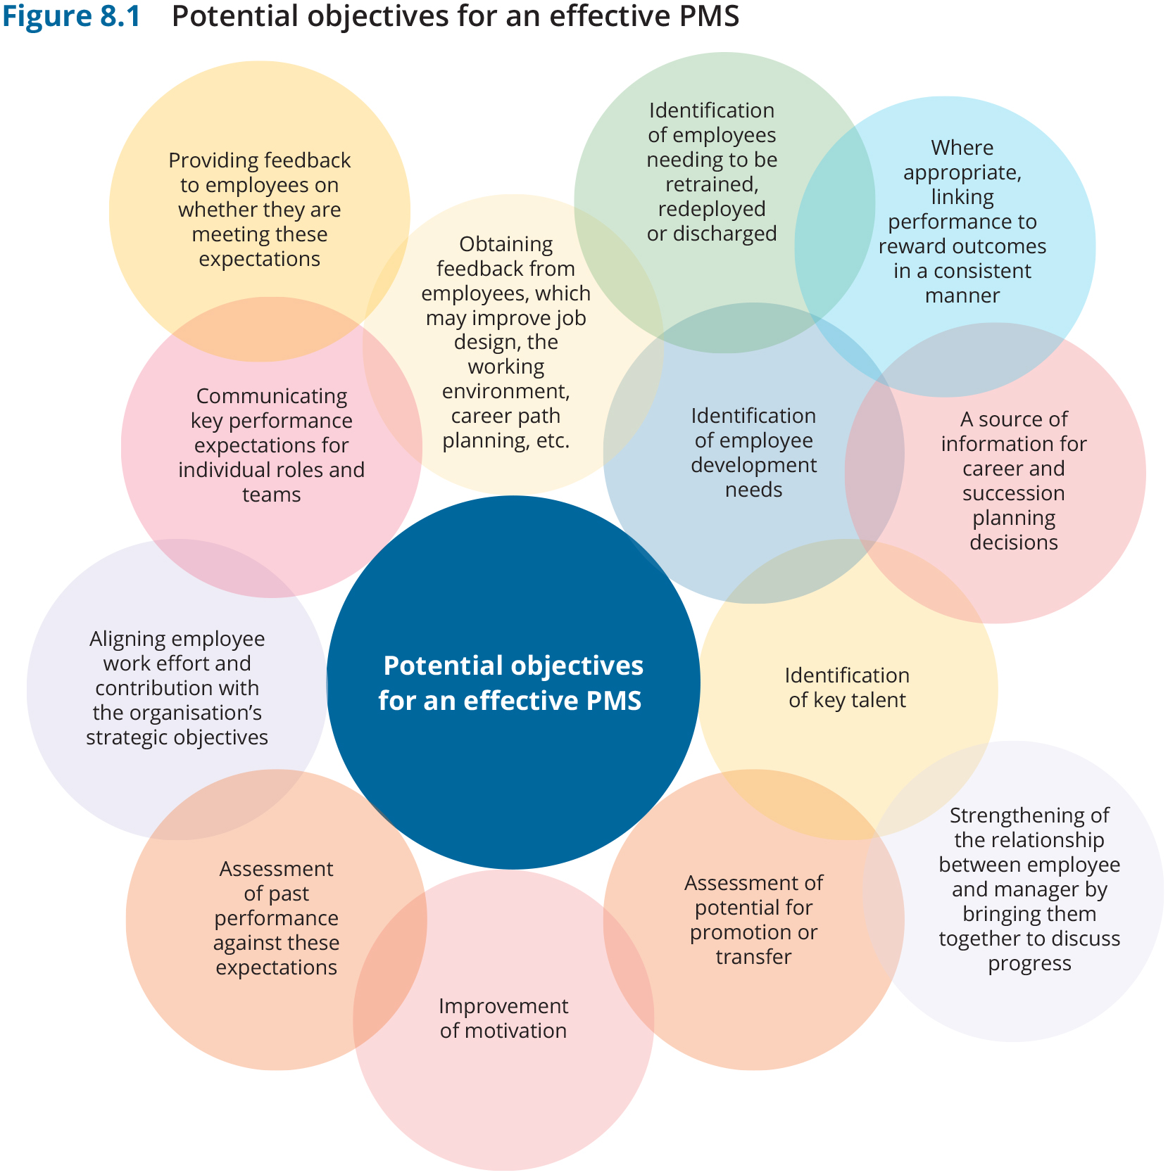
Notes:
Added a new slide

Slide 11
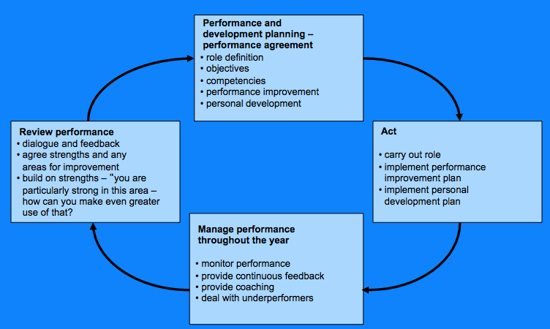
The Performance Management Cycle
Source: Armstrong (2010)

Slide 12
Video
Employee Performance Management https://www.youtube.com/watch?v=J_Qe9MMDAms

Slide 13
Objectives of Performance Management Systems
Individual
Organisation
Recognition
Reward
Improve performance
Development
Express aspirations / concerns / feedback
Improve performance
Motivation, recognition
Legal defence
Feedback
Communicate
HRD / training needs information
Pay / promotion
Staff retention/reduction
Control across MNC

Slide 14
Performance Management Systems in Operation
Objectives / Expectations
Delegate / Empower
HRD
Coach
PA
PRP
HRD
Notes:
Objectives – setting clear goals and objectives. SMART (specific, measurable, achievable, realistic and time-bound).
Delegation – assign work tasks. But first assess the developmental level of the individual and their readiness for the delegated tasks.
HRD – if employees are to meet performance expectations, they must have the necessary KSA.
Coaching – involves monitoring and improving performance. Employees need information about their performance and guidance as to how to improve.
PA – measuring the outcomes.
Outcomes of PA – PRP and HRD
Separate processes for deciding on PRP and HRD needs.

Slide 15
PM and ORGANISATIONAL justice
A PMS system’s effectiveness will by influenced by the notions of procedural justice and distributive justice:
Procedural justice： employee perceptions regarding the fairness of the decision-making procedures applied to their work
Distributive justice：employee perceptions regarding the fairness of the outcomes arising from the PM procedures, including performance scores, promotion outcomes, pay adjustment and employment continuity.
Notes:
New slide

Slide 16
Measuring Performance – Performance appraisal is:
‘A systematic approach to evaluating employees’ performance, characteristics or potential with a view to assisting with decisions in a wide range of areas such as pay, promotion, employee development and motivation’.
(Gunnigle et al, 1997: 145)

Slide 17
Performance Appraisal
Purpose:
Provide feedback to the employee
Ensure commitment to future improvement and development
Opportunity to communicate:
Past performance
Current concerns
Future goals
Ensure feedback is:
Credible
Specific
Constructive
Accompanied by concrete examples of good/poor performance

Slide 18
Performance Appraisal Methods
Rating scales
Ranking scales
Free form
Performance/Results-oriented systems (MBO) – specification of objectives, participation in agreeing objectives, performance measurement against objectives, feedback and monitoring
Self-assessment
Assessment centre
Competency-based methods (BARS)
Peer, upward, 360 degree feedback
Measuring
performance
Notes:
BARS – evaluates the employee on specific behaviors required for each individual position in a company – focuses on role relevant criteria – takes account of the views of both employee and manager.
If you can’t measure it, you can’t manage it (Drucker).

Slide 19
360 Degree Feedback – broadening the contributors
Manager
Peers
Employee
Customers
Reports

Slide 20
Why appraise? – employer perspective
Assess performance of individuals
Set individual objectives
Assess attainment of objectives
Determine who should be promoted
Determine who needs training
Hunt (1992)

Slide 21
Why appraise? – employee perspective
A career development exercise
Clarifies role, duties, objectives
Identifies employee potential
Identifies employee needs
Hunt (1992)

Slide 22
Video – Performance Appraisal Meetings
https://www.youtube.com/watch?v=E34Zt1cEpFA

Slide 23
A move away from annual appraisals?
Criticisms of annual appraisal systems
Google, Facebook and Netflix ‘bypassed them entirely’.
Deloitte, Accenture, Microsoft, Gap & Expedia – have moved towards more frequent and less formal ways of appraising performance.
Increasing emphasis being placed on continuous feedback.
‘Appraisals are finished. What’s next?’, People Management, August 2015

Slide 24
‘We’ve stopped rating people and started talking to them’ (People Management, November 2015)
KPMG:
Forced distribution rating system
Resulting in little loyalty to the organisation
Negatively impacting on staff retention
Removed rating system two years ago
Focus now on having ‘conversations’ with staff

Slide 25
The Appraisal Interview
Preparation
Privacy and confidentiality
Adequate notice
Set stage
Establish rapport
Good questioning technique
Give feedback
Encourage input
Summarise
Notes:
Areas typically appraised:
Job knowledge and abilities
Adaptability/flexibility
Productivity
Quality of work
Attitude to work (commitment, motivation, enthusiasm)
Interaction with others (communication skills, team-working)
Problem-solving
Setting priorities, ability to plan and organise work
Attendance and time-keeping
Need for supervision
Performance against targets

Slide 26
Performance Management - some potential problems
Inconsistent management and administration
Rewards versus Development
Line manager support
Process not applied consistently across the organisation
Not all managers are good at giving feedback

Slide 27
Performance Evaluation - Issues/Dilemmas
nature of objectives
measured against what criteria (results, competencies, behavioural scales)
frequency (measurement/feedback)
rating/use of overall ratings
communication/ownership
management role
potential to de-motivate
Notes:
Formal evaluation annually, but managers to give ongoing feedback on an informal basis.
Use of ratings – a very narrow way to evaluate performance which can have so many dimensions to it???
Who should take ownership of the PM process?
Senior Management
HR
Line managers
Employees
Management Role – to show support and commitment to the process, to be part of the process.

Slide 28
Line Manager and Performance Management
Roles: appraiser, coach, adviser, referral agent
Ability/training – skills in giving feedback
Time constraints & value of performance management/appraisal

Slide 29
Forces transforming the performance management landscape
Reorganisation of work
Less hierarchical organisations and self-managing job assignments
Flexible network-based organisational structure
Requires recalibration of performance management criteria with a work-group focus.
Remote work requires more direct behavioural observation than in the past.
Alternative methods of appraisal for hybrid work model
‘Autonomy paradox’ for knowledge workers
Notes:
Added a new slide

Slide 30
Forces transforming the performance management landscape
Digital Innovation
AI, machine learning, quantum computing can minimise the problem of backward-facing performance review.
Remote electronic monitoring
The generation Z workforce
Generation Z differ in terms of work attitudes, values, technology and education, thus have different expectations about their contribution being measured.
Work to live, instant gratification, prize opportunities for personal growth are unique for generation Z.
Notes:
Added a new slide

Slide 31
