Slide 1
Bachelor of Business Studies (BBS)
Topic 4 & Topic 5: Recruitment & Selection
© Business eLearning

Slide 2
Presentation objectives
To review different approaches to and methods of
recruitment
To explain the concept of employer branding
To review and discuss different methods of selecting candidates
To discuss the role of induction and onboarding
2

Slide 3
Reading
Core textbook –
Chapter 5 & 6
3

Slide 4
How to address workforce gaps?
(Mercer.com)
5

Slide 5
Recruitment and Selection:
systematic approach
Who to we want? (JOB ANALYSIS)
How we attract them? (RECRUITMENT)
How we identify them? (SELECTION)
How do we know we got it right? (EVALUATION)
Who should be involved in this
proces?
5

Slide 6
Recruitment
Recruiting: any activity carried on by the organization with the primary purpose of identifying and attracting potential employees.
Role of HR recruitment is to build a supply of potential new hires that the organization can draw on if need arises.
„Talent Pipeline”
6

Slide 7
But First........Do we need to recruit?
Can the work be covered in another way?
Are all the tasks necessary?
Can the tasks be incorporated into another post? Should the job be re-designed?
Can the work be done on a part-time/job-sharing basis?
Presentation by Dr. Ilona Hunek©

Slide 8
Job analysis
Abilities, skills, knowledge necessary to perform the job
Attitudes and behaviours
Output: job description and person specification
Photo: Anna Shvets z Pexels

Slide 9
JOB ANALYSIS
Jobs have outcomes, responsibilities, tasks and functions.
Overall, all jobs should relate to achieving corporate or strategic objectives.
Jobs are constantly changing due to internal and external factors and domestic and global forces.
Job analysis is:
the accurate analysis, design and implementation of jobs
an ongoing process of determining the competencies required to ensure jobs remain relevant.

Slide 10
Job analysis outputs
Job description
Person specification
Job Title
Department
Location
Reports to
Purpose
Main Tasks
Liaison and Main Contacts
Staff Responsibilities
Special Features
Rewards and Conditions
Education
Experience
Skills
Motivation
Disposition/Circumstances

Slide 11
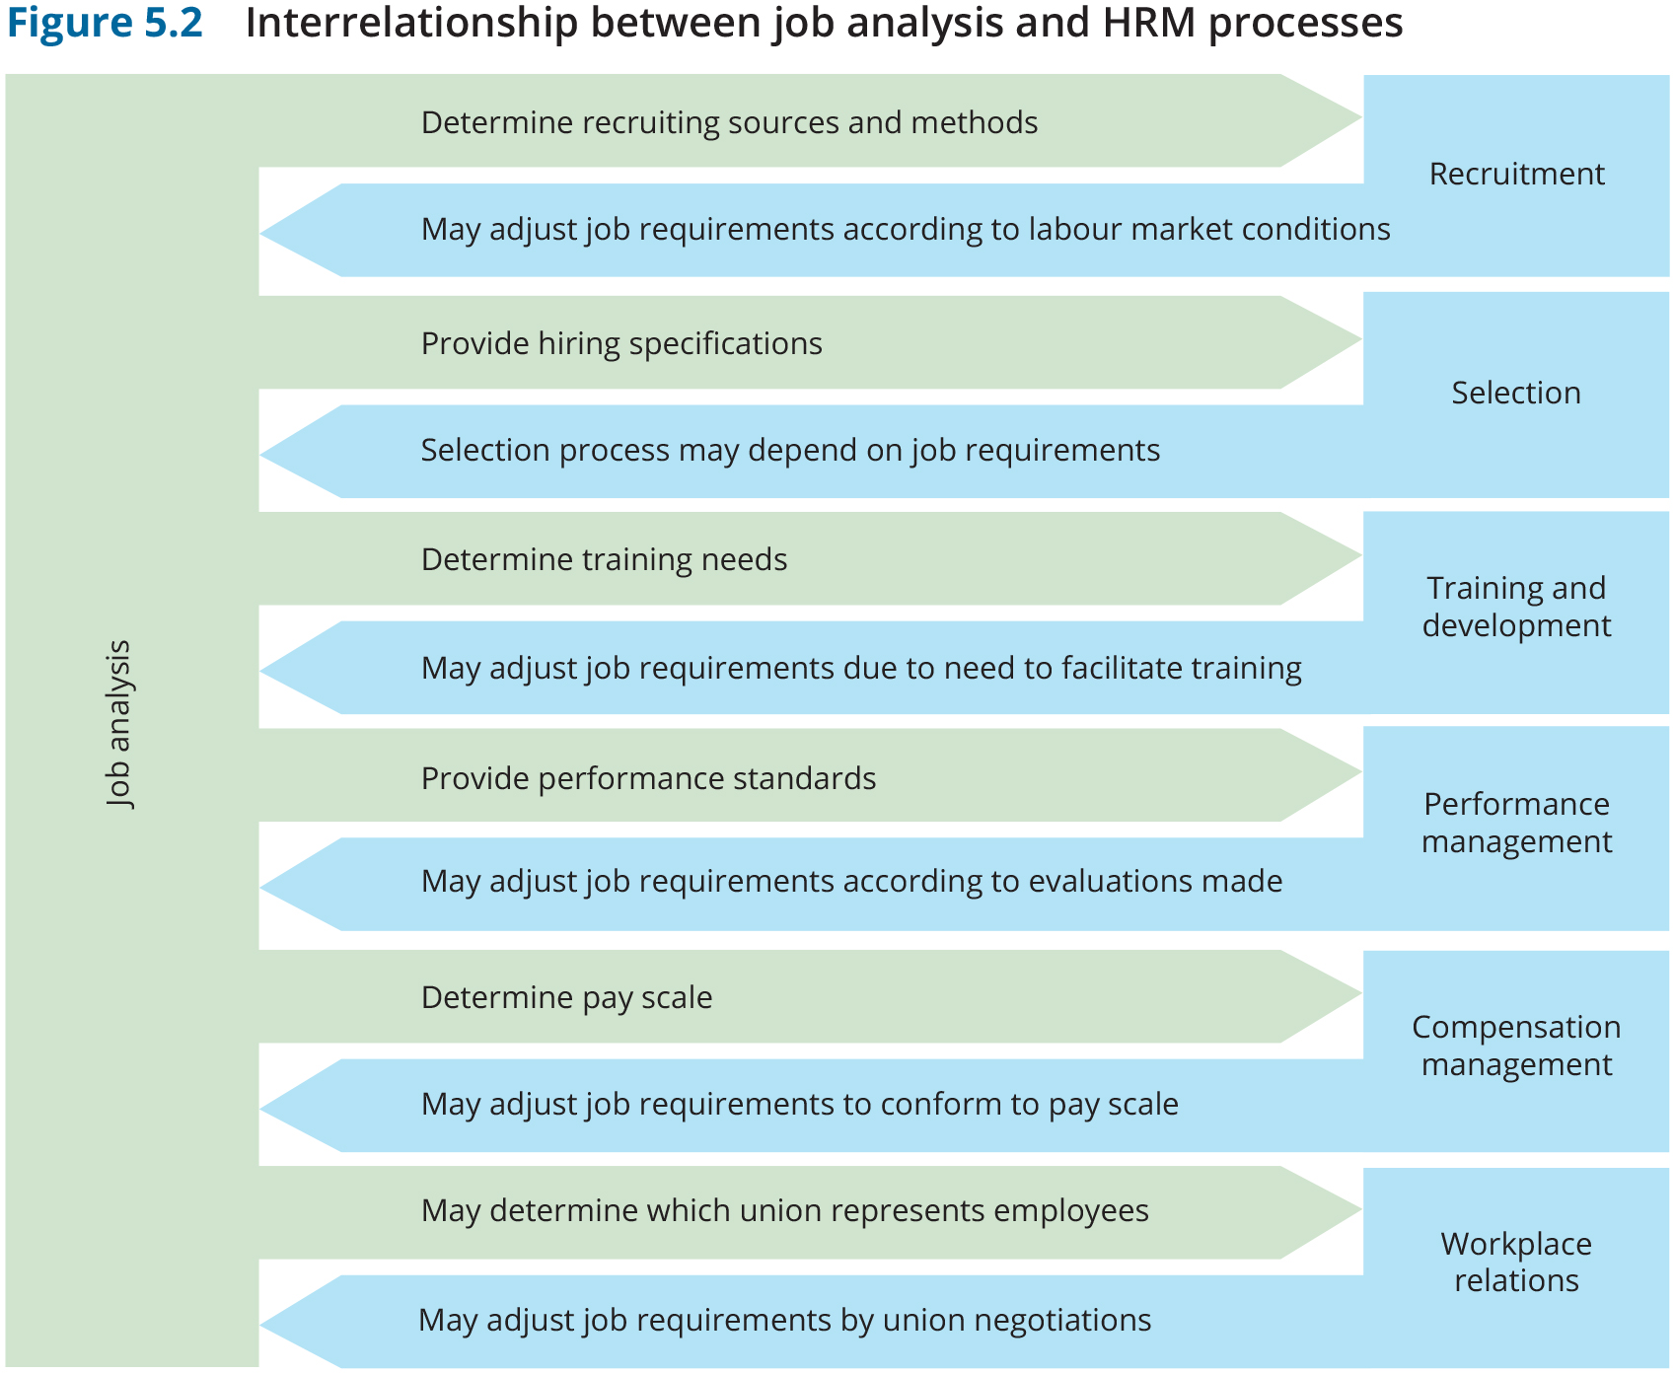

Slide 12
Assistant Manager, Recruitment (6 months contract)
Kuala Lumpur (RedQ) ID: JR0012723
Job Description
Job Description
You will be proactively sourcing for senior local talents, take a lead on recruitment hiring projects and drive overall recruitment excellence. You should be passionate about recruiting for technical talents where hiring speed and hiring standards are high.
You also enjoy working in an ambiguous environment where speed and customer obsession are key attributes for success.
You have a growth mindset, are unafraid to experiment, and propose solutions based on recruitment data. This is a 6 months contract position to start with.
You will:
Develop long term relationships with the business on a global scale that meet multiple needs
Across Asia increase visibility and knowledge of AirAsia as a Travel Tech company among talents who fit the profile
Run full-cycle recruiting by ensuring high standards for fast hiring is in place
Attend career fairs, interact with students and promote our employer brand
Increase our social media presence and drive social media campaigns to meet hiring needs for assigned roles
Provide timely reporting of key recruitment metrics and insights to drive decisions and improve the process
Engage and collaborate with hiring managers and drive high satisfaction of recruitment service provided to them
Independently drive recruitment projects with the aim of optimizing recruitment process, increase quality and speed of delivery
You have
At least 8 Years of relevant working experience a fast-paced, high-growth environment
Experience hiring senior positions, C-suite and foreign talents
Have worked on high volume roles but also niche positions
Experience in building relationships with partners and customers, externally and internally
Experience developing a strategy, planning and executing against that strategy
You are self-driven and able to deliver results in an ambiguous environment
Strong communication and collaboration skills across all levels
You are able to travel to execute hiring drives

Slide 13
Internal recruitment
Job Posting: process of communicating information about a job vacancy:
On company bulletin boards
In employee publications
On corporate intranets
Anywhere else organisation communicates with employees

Slide 14
External recruitment: sources
Direct applicants
Employee referrals
Advertising
E-recruitment
Public employment agencies
Private employment agencies
Colleges and universities

Slide 16
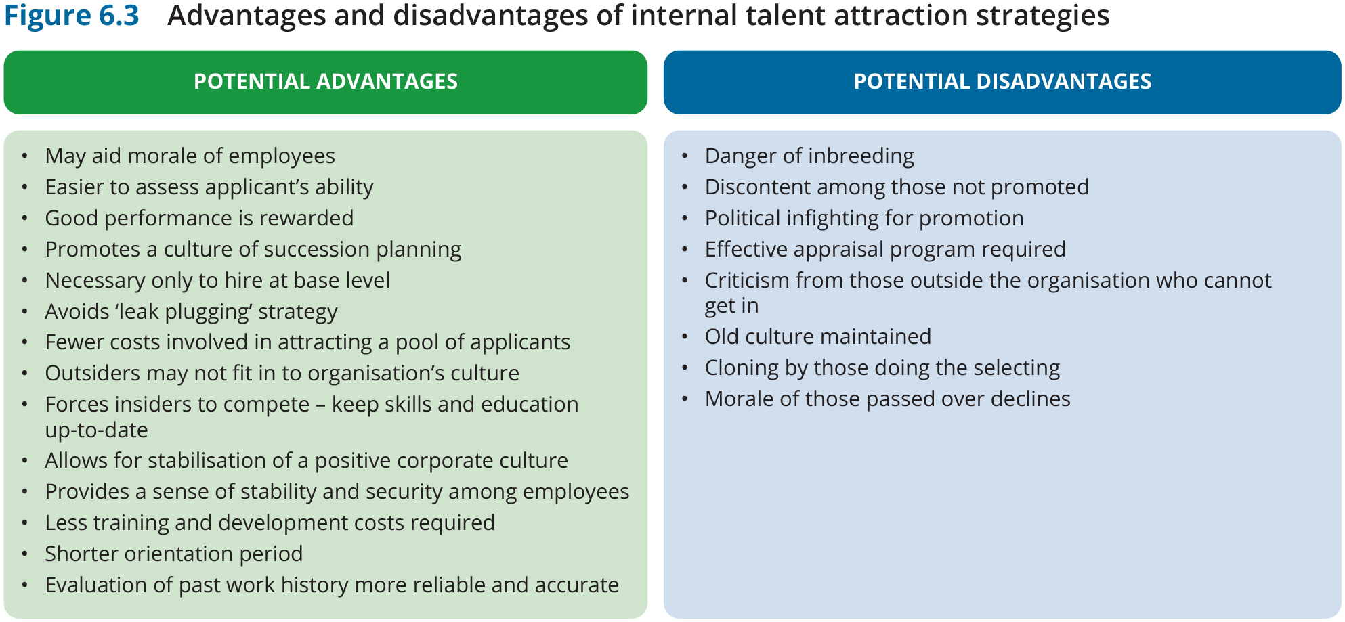
Internal versus external talent attraction strategies

Slide 17
Recruiting talent
Attracting right people to apply for a vacancy
Creating a positive image of the company

Slide 18
Employer branding
„What people say about you when you
are not in the room”
(Jeff Bezos, Amazon)

Slide 19
Employee Value Proposition
What organisation has to offer = Employee Value Proposition
Unique set of benefits that employee receives in exchange for skills, capabilities and experience brought to the company.
Two-way nature of recruitment process

Slide 20
Employer Branding
3 Videos: Deloitte, Google and Intel
Note what what the companies are using to build their brand.
What is the EVP

Slide 21
Employer branding: Deloitte

Slide 22
Employer branding: Google

Slide 23
Employer branding: Intel

Slide 24
Employer branding
Make an impact Lead and suport Global
Your matter (voice, life)
Images: sport, culture
Innovation Learning Fun Support
Personal stories, work
Glamour Impact Cool Rock star

Slide 25
EMPLOYERS OF CHOICE
‘War for talent’ spawned a push for organisations to become ‘employers of choice’.
Strategic views of employers of choice will vary between the attitude and values held by different generations
Best employer awards:
- awareness that getting credentials right result in higher rates of attraction and retention.
- recognises both organisations’ outstanding HR achievements and their attractiveness for recruits.
- investing in creating their ‘brand image’.
- promoting a range of benefits to attract the ‘best’.

Slide 26
Realistic job preview
Realistic job preview
– background information about job’s positive and negative qualities.
Help to understand the culture and requirements.
Videos, interactive online quizzes, site visits.
Image: cottonbro@Pexels

Slide 27
Selection
Aim - to predict aplicant’s job performance capacity
FIT
Person – job
Person - organisation

Slide 28
Selection process
HOW TO MAKE RIGHT DECISION?
Noe et al. (2017) Fig. 6.1 p. 169

Slide 29
Measuring the Effectiveness of Selection Tools and Methods
Method provides reliable information – free from random errors (not leaving too much to chance).
Method provides valid information – measures what it is supposed to measure.
Method offers high utility –value is greater than cost of using .
Information can be generalized to apply to candidates.
The selection criteria are legal.

Slide 30
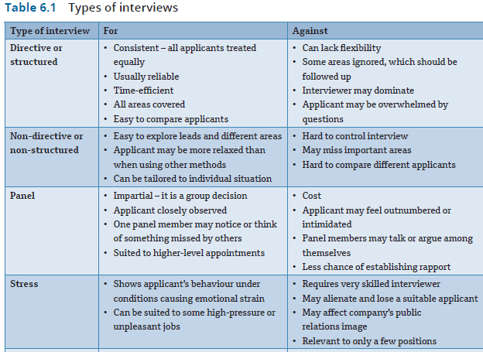
TYPES OF INTERVIEWS

Slide 31
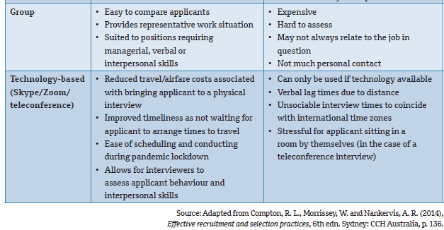
TYPES OF INTERVIEWS (cont.)

Slide 32
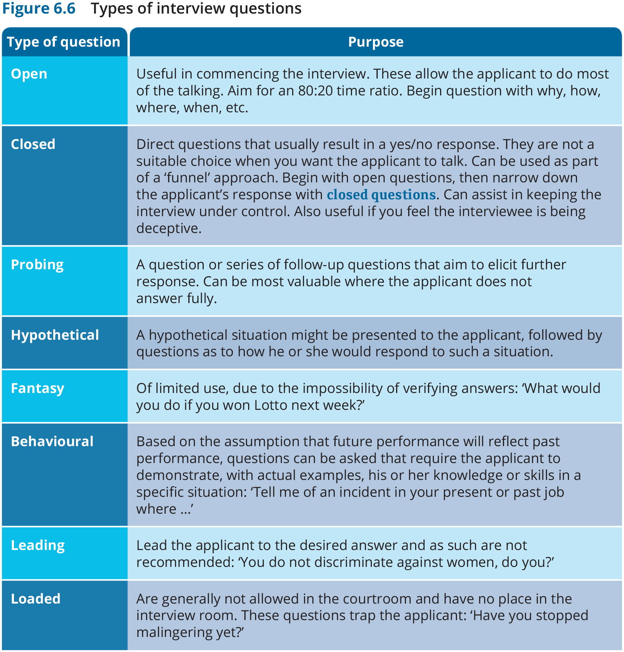
Questioning

Slide 33
Types of employment tests
Commercially available tests:
job knowledge tests
job sample tests
psychological test
psychometric test
gamified test.

Slide 34
Background checks
To verify that applicants are as they represent themselves
Criminal record?
Internet allows for faster check
70% employers
checks candidates social
media
CareerBuilder survey 2008
Image: michael burrows@Pexels

Slide 35
Induction and onboarding
Induction – introducing a new
employee to organisation and job
Onboarding – a process of getting new employees adjusted to social and performance aspects of their jobs
„Induction crisis” – potential the the new employee leaves the company within first 6 months
Image: Rawpixel

Slide 36
Induction at Deloitte
Video
Note how what is important in organizing induction.

Slide 37
Induction at Deloitte

Slide 38
Recruitment and selection:
evaluation
Performance indicators for each stage of the process
Cost effectiveness of the process
Attraction rate of different ads
Sources of applicants
Success rates of different interviewers
Successful candidates’ actual performance on the job
Candidates’ – successful and unsuccessful – perception of the process
Equality issues, e.g. gender balance of interview boards, attraction of previously under- represented groups
Training of selectors
Offer rejections and why
Retention rates
The profile of the workforce
‘Fit’ of the recruitment and selection strategy with the business strategy

Slide 39
The costs of getting it wrong
Further recruitment and selection costs.
Additional development and orientation costs.
Opportunity costs.
Loss of competitive advantage.
Damage to company brand.
Loss of employer of choice status.
Reduced internal status.
Impaired recruitment opportunity.
Threatened company viability.
Loss of other key staff.

Slide 40
Summary
Process of sourcing talent contains recruitment, selection and onboarding
Recruitment activities are targeted at attracting talent and building employer branding
The aim of selection is to predict performance capacity of candidates using several methods
Induction and onboarding help new employees to adjust to their jobs and organisational culture

