Slide 1
Performance management and reward
TASK 5

Slide 2
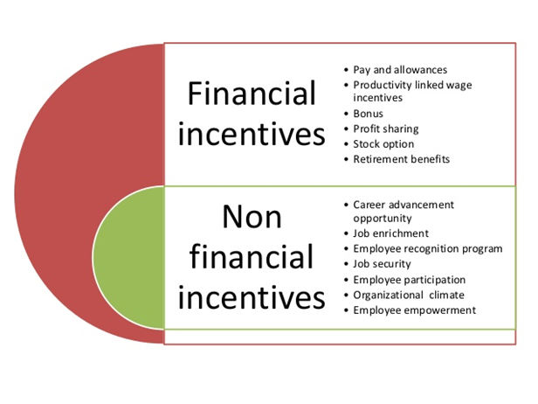
AC 5.1
Notes:
Financial Incentives
The special sorts of Financial Incentives are as follows:
Salary – It is the primary Financial Incentive for any worker to paintings diligently for the enterprise. It consists of additives like primary pay, residence hire allowance, dearness allowance and different such benefits.
Bonus – It is a consolidated quantity that an worker receives from the enterprise for acting well. It can act as a effective motivator for the worker. The bonus also can be for precise activities like fairs or different crucial occasions for the company. The bonus may be with inside the shape of economic benefits, paid vacations, gifts, etc.
Performance-primarily based totally incentives – Employees may additionally get increments primarily based totally on their overall performance aside from the every year hike on primary pay. It can encourage the worker to preserve enhancing their efficiency.
Stock options – Firms can provide everyday stocks to personnel at prices under the marketplace price. These stocks can act as a motivator for personnel with the aid of using making them component proprietors of the company
Non-Financial Incentives
The special forms of Non-Financial Incentives are as follows:
Appreciation – Giving due reputation for an worker’s paintings encourages them to be extra diligent and committed toward their activity. It offers a fillip to their shallowness and motivates them. Companies have worker reputation applications in which they claim the exceptional performers from time to time.
Promotion – An worker’s cutting-edge designation displays their role with inside the organisational chart. It determines their stage of obligation and authority, salary, bonus and different benefits. To maintain an worker motivated, businesses can sell them to enhance their status with inside the agency and inspire them to keep their proper paintings.
Career opportunities – Companies can offer profession improvement applications for his or her personnel to present them a risk to research new abilities. These abilities can assist them observe for senior positions with inside the agency.
Job enrichment – Organisations can layout jobs to contain better expertise and talent levels, extra obligation and autonomy to inspire personnel. It will provide them a risk to specific themselves whilst additionally offering extra profession increase and improvement opportunities. They also can installation committees comprising personnel from special departments and searching for their enter in enriching activity roles (BYJU'S, 2020)..

Slide 3
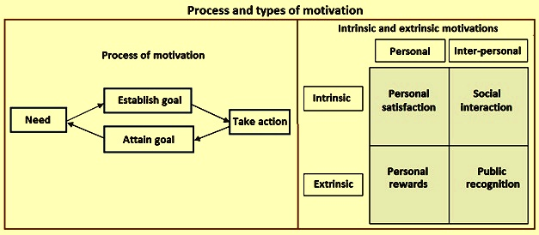
AC 5.2
Notes:
Intrinsic motivation refers back to the motivation which comes from inner of an individual. This motivation is generated thru pride or satisfaction which one receives in finishing or maybe running on a venture. Factors which have an effect on on intrinsic motivation consist of responsibility, freedom to act, scope to apply and increase capabilities and abilities, thrilling paintings and possibilities for advancement. These motivators, that are worried with the pleasant of labor life, generally tend to have a long-time period impact on the grounds that they're inherent in people and now no longer imposed from outdoor.
Extrinsic motivation is some thing that is carried out to or for personnel to inspire them. It arises from elements outdoor an individual, together with money, grades, complaint or punishments. These rewards offer pride and satisfaction that the venture itself won't offer. Extrinsically prompted personnel can paintings on a venture even if they've little hobby in it. This sort of motivation commonly has an instantaneous and effective impact, but it does now no longer generally tend to closing for long (satyendra, 2013)..
Herzberg’s motivation principle is one of the content material theories of motivation. These try to give an explanation for the elements that inspire people via figuring out and pleasurable their man or woman needs, goals and the goals pursued to fulfill those goals.
This principle of motivation is called a component content material principle. It is primarily based totally upon the deceptively easy concept that motivation may be dichotomised into hygiene elements and motivation elements and is frequently known as a ‘ want system’.
These separate ‘needs’ are the want to keep away from unpleasantness and soreness and, at the alternative give up of the motivational scale, the want for private development. A scarcity of the elements that definitely inspire personnel (the motivating elements) will purpose personnel to recognition on other, non-task related ‘hygiene’ elements (GLOBAL, 2019)..

Slide 4
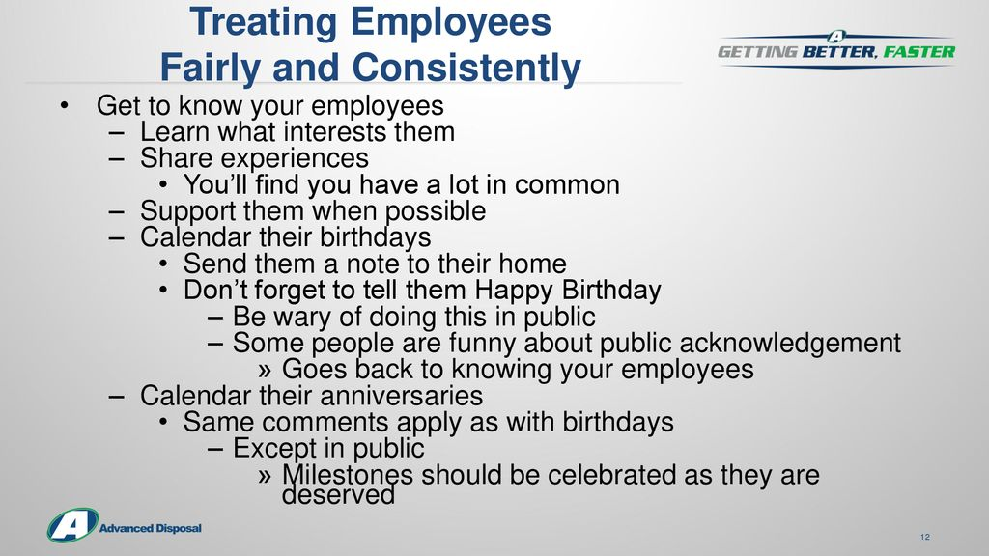
AC 5.3
Notes:
Providing identical pay for all personnel may also lessen the dangers of going through an identical pay declare and assist avoid:
Expensive criminal prices that can value heaps of pounds
Lost productiveness as control accumulate proof and address tribunal hearings
Damaged worker family members and occasional body of workers morale
Cost of tribunal decisions - similarly to their very own criminal prices, employers who lose must pay the claimant a economic award, that can consist of up to 6 years’ returned pay and, in a few circumstances, the claimant’s criminal prices
Loss of popularity with customers, shareholders and capacity personnel
Possible similarly audits ordered with the aid of using a tribunal
Apart from supporting you to satisfy your criminal obligations on identical pay, wearing out an identical pay audit or evaluate may have different useful effects. For instance, it can display different equality problems for your organization, inclusive of under-illustration or activity segregation of human beings with positive covered characteristics
contributions to the company.
Employees in each and every sector greatly benefit when they are being provided equal pay. This has been made mandatory under the Equality act 2010. Moreover, treating employees fairly also sends out a positive message for the organizations. This not only increases the efficiency of employees but also it also reduces absenteeism (Anon., 2018)

Slide 5
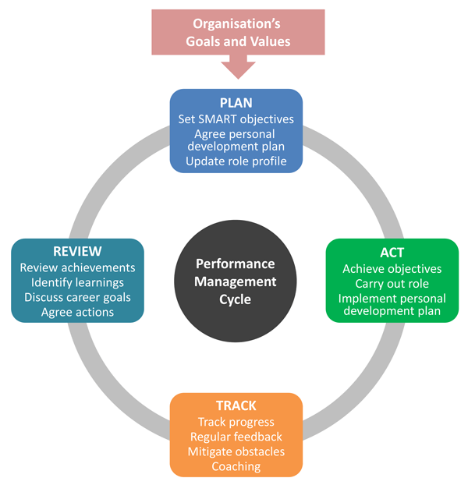
AC 4.1
Notes:
What are the factors of a overall performance control machine?
When you’re thinking about key factors of a overall performance control machine, it’s essential to recollect all components of your overall performance control cycle. The proper software program will assist you are making overall performance control less difficult at each stage.
1. Planning
It’s essential your overall performance control machine allows you facilitate key making plans sports like putting and aligning on worker desires. This allows shield organizational alignment and offers an possibility for employees, teams, and leaders to define an movement plan.
2. Monitoring
Your overall performance control machine have to assist you song key metrics and display worker development to make sure worker and group desires are reached. This is essential in addressing roadblocks and motivating productivity.
3. Reviewing
It’s key that your overall performance control machine allows you successfully assessment an employee’s overall performance and very last results. The proper machine will facilitate the conversations that permit managers to offer feedback, apprehend the employee’s perspective, and create overall performance plans for the future.
4. Rewarding
Your overall performance control machine must come up with the equipment to praise personnel for his or her efforts. By offering ok recognition, leaders can encourage personnel closer to premiere overall performance with inside the future.
A overall performance control system enables leaders constantly music and educate worker overall performance. Not handiest do those structures make certain that personnel are operating efficiently closer to aligned organizational goals, however they assist leaders expand their skills closer to most effective overall performance (Wickham, 2022)..

Slide 6
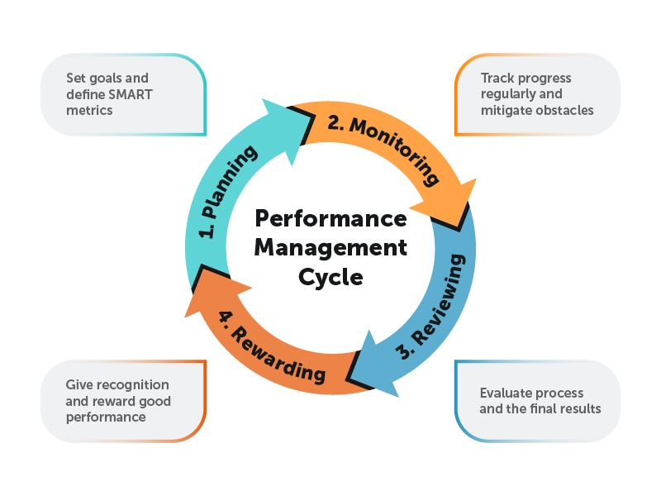
AC 4.2
Notes:
Clear desires. The maximum essential component that characterizes a excessive appearing crew is that every one crew participants have a clean
photograph of wherein they're heading – clean desires. This may appear obvious, but it isn't always the case for maximum groups. Even if all crew participants recognize what the desires are, they're in all likelihood to have unique reviews of what it takes to reap them. At the identical time, the phrases used to explain the desires can suggest unique matters for unique people. It is vain to paintings difficult to reap the desires until every person has a not unusual place and clean view of the desires.
Clear roles with inside the crew. When the desires are clarified and the crew has a not unusual place know-how of them, it's time to begin organizing.
Decide what wishes to be done, while and via way of means of whom. While additionally this issue can be visible as not unusual place sense, a variety of groups have exceptional issue in reaching it. First, expectancies of every man or woman should be clean, in addition to how the tasks need to be performed. Secondly, every man or woman should have the proper competencies to be capable of carry out their tasks. Finally, every man or woman should be given his or her assigned role.
Situational management. Team leaders want to be bendy in their management, to fulfill the unique wishes of the crew in the course of unique
phases. When the crew dynamics change, the management should adapt accordingly.
Communication and remarks. In excessive appearing groups everyone receives their say no matter age, identify and gender and the verbal exchange is visible as open and allowing. Members deliver regular, positive remarks to every different on man or woman overall performance and contributions. This ends in over all development of tactics in addition to non-public development.
Discussion, decision-making and planning. A exceptional deal of time is spent on planning, a way to resolve troubles and make decisions. High appearing groups determine together how to make decisions before they take decisions (STEPS, 2019)..

Slide 7
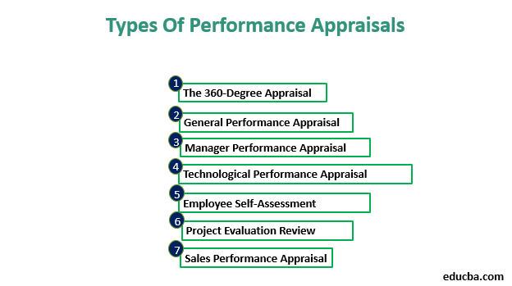
4.3
Notes:
1. The 360-Degree Appraisal
This technique entails giving out a questionnaire with questions regarding a colleague’s overall performance they want to fill it up. The supervisor can keep in mind this comments with the aid of using comparing the overall performance on the stop of the quarter/year.
2. General Performance Appraisal
This technique entails non-stop interplay among the worker and his supervisor, non-stop placing of dreams and accomplishing them. Whether the worker has been capable of do justice the whole procedure or now no longer is evaluated on the stop of the year.
3. Technological/Administrative Performance Appraisal
This appraisal approach concentrates on technical greater than another element of overall performance at the activity because the personnel concerned have specialized abilities. They’re judged at the abilities they own and the interest they complete.
4. Manager Performance Appraisal
A manager’s overall performance have to additionally be appraised, and this consists of now no longer simply his/her overall performance at the activity however additionally dating control with customers at his/her disposal. Generally, nameless remarks bureaucracy are received, that are then taken into consideration for appraisal.
5. Employee Self-Assessment
This approach may be very unpopular amongst personnel as no person can cope with score himself or herself. The self-evaluation sheet is as compared with the only crammed up with the aid of using the supervisor and the variations are discussed.
6. Project Evaluation Review
This approach includes overall performance appraisal of the crew participants concerned on the give up of each mission and now no longer on the give up of each year. This facilitates the crew and its participants increase with every passing mission.
7. Sales Performance Appraisal
A salesclerk is evaluated on the premise of his/her income abilities and accomplishment of economic desires set previously. Goals set in case of income ought to be sensible and methods of attaining them ought to be determined with the aid of using the worker and the supervisor concerned (THAKUR, 2018)..

Slide 8
REFERENCES
Below
Notes:
References:
Anon., 2018. Why equal pay matters. [Online]
Available at: https://www.equalityhumanrights.com/en/advice-and-guidance/why-equal-pay-matters
BYJU'S, 2020. Financial and Non-Financial Incentives. [Online]
Available at: https://byjus.com/commerce/financial-and-non-financial-incentives/
GLOBAL, A., 2019. Understanding Herzberg's motivation theory. [Online]
Available at: https://www.accaglobal.com/gb/en/student/exam-support-resources/fundamentals-exams-study-resources/f1/technical-articles/herzbergs-motivation.html
satyendra, 2013. Motivation and Rewards. [Online]
Available at: https://www.ispatguru.com/motivation-and-rewards/
[Accessed 14 July 2013].
STEPS, B., 2019. 5 Key Factors to Managing Successful Teams. [Online]
Available at: https://www.bluesteps.com/blog/5-key-factors-managing-successful-teams
THAKUR, M., 2018. TYPES OF PERFORMANCE APPRAISAL. [Online]
Available at: https://www.educba.com/types-of-performance-appraisal/
Wickham, N., 2022. What is a Performance Management System and How to Choose One. [Online]
Available at: https://www.quantumworkplace.com/future-of-work/performance-management-system-questions
[Accessed 20 JANUARY 022].

